Slide 2


Slide 3


Slide 4


X

Slide 5


Core Data Concepts
Measures of Data
X

Slide 6
Core Data Concepts
Fundamentally at the core of using data science to solve real world problems and find solutions to business challenges, we use data.
It’s important to understand core concepts of data before continuing on to use it with a variety of methods.
X

Slide 7
Core Data Concepts
In this section of the course we’ll focus on some core topics to understanding data.
As we begin to learn about probability, statistics, and visualizations regarding data, we should take some time to understand what we mean by the term “data”.
X

Slide 8
Core Data Concepts
What is data?
X

Slide 9
Core Data Concepts
What is data?
Collected observations and information about something, which can be structured or unstructured.
Let’s think about a few examples of data…
X

Slide 10

Core Data Concepts
Data Examples:
Information about penguins
X

Slide 11
Core Data Concepts
Data Examples:
Information about penguins
Penguin ID | Flipper Length (mm) | Body Mass (g)
0 | 181.0 | 3750.0
1 | 186.0 | 3800.0
2 | 195.0 | 3250.0
3 | 193.0 | 3450.0
X

Slide 12
Core Data Concepts
Data Examples:
Notice unit of measurements and structure.
Penguin ID | Flipper Length (mm) | Body Mass (g)
0 | 181.0 | 3750.0
1 | 186.0 | 3800.0
2 | 195.0 | 3250.0
3 | 193.0 | 3450.0
X

Slide 13
Core Data Concepts
Data Examples:
Not all data needs to be numeric!
Penguin ID | Flipper Length (mm) | Body Mass (g) | Sex
0 | 181.0 | 3750.0 | Male
1 | 186.0 | 3800.0 | Female
2 | 195.0 | 3250.0 | Male
3 | 193.0 | 3450.0 | Female
X

Slide 14
Core Data Concepts
Data Examples:
This is actually a real dataset! The data was collected and made available by Dr. Kristen Gorman and the Palmer Station, Antarctica LTER, a member of the Long Term Ecological Research Network.
X

Slide 15
Core Data Concepts
Types of Data:
So far we’ve seen that data doesn’t need to be numerical (e.g. color of cars).
We can distinguish between different types of data, such as continuous vs. discrete data. As well as structured data vs. unstructured data.
X

Slide 16
Core Data Concepts
Data Vocabulary:
Let’s explore some core concepts and the vocabulary used to describe them:
Continuous vs. Discrete (Categorical)
Structured vs. Unstructured
Nominal vs. Ordinal
Population vs. Sample
X

Slide 17
Core Data Concepts
Continuous vs. Discrete:
X

Slide 18
Core Data Concepts
Continuous vs. Discrete:
Discrete Data:
Can only take certain values, there are no values “in-between” values.
X

Slide 19

Core Data Concepts
Continuous vs. Discrete:
Discrete Data:
Can only take certain values, there are no values “in-between” values.
Car models: Toyota, Tesla, Ferrari
X

Slide 20

Core Data Concepts
Continuous vs. Discrete:
Discrete Data:
Can only take certain values, there are no values “in-between” values.
Playing Card Values: A,2,3..J,Q,K
X

Slide 21

Core Data Concepts
Continuous vs. Discrete:
Discrete Data:
Note that discrete data can be numeric. Such as the possible values of rolling a single die are only 1,2,3,4,5 and 6.
X

Slide 22
Core Data Concepts
Continuous vs. Discrete:
Continuous Data:
Can take any value, there are an “infinite” amount of values in-between any two values if you are able to get precise enough.
X

Slide 23

Core Data Concepts
Continuous vs. Discrete:
Continuous Data:
Height of people is a continuous value (e.g. 172 cm tall or 173 cm tall).
X

Slide 24
Core Data Concepts
Continuous vs. Discrete:
Continuous Data:
Notice how someone could be in between that at 172.5 cm tall.
X

Slide 25
Core Data Concepts
Continuous vs. Discrete:
Continuous Data:
Notice how someone could be in between that at 172.5 cm tall, or 172.54 cm tall, or 172.542cm.
X

Slide 26
Core Data Concepts
Continuous vs. Discrete:
Remember that while continuous data is numeric (160kg), discrete data can be numeric (dice roll of 2) or a string (“Blue”).
Keep in mind that sometimes the context and framing of a dataset will decide whether you should think of data as continuous or discrete.
X

Slide 27
Core Data Concepts
Continuous vs. Discrete:
For example, is color data continuous or discrete?
X

Slide 28
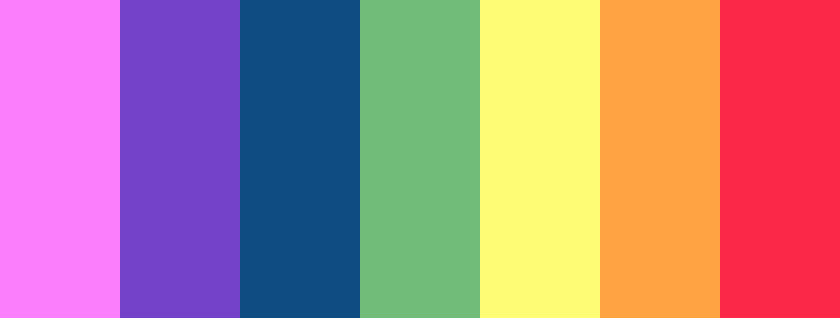
Core Data Concepts
Continuous vs. Discrete:
For example, is color data continuous or discrete? You may want to immediately say discrete:
X

Slide 29
Core Data Concepts
Continuous vs. Discrete:
For example, is color data continuous or discrete? But what if the context is physics and the visible spectrum of light in wavelengths?
X

Slide 30
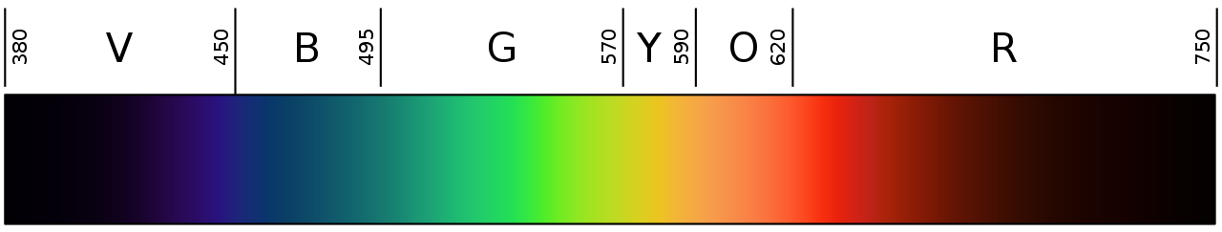
Core Data Concepts
Continuous vs. Discrete:
For example, is color data continuous or discrete? But what if the context is physics and the visible spectrum of light in wavelengths?
X

Slide 31
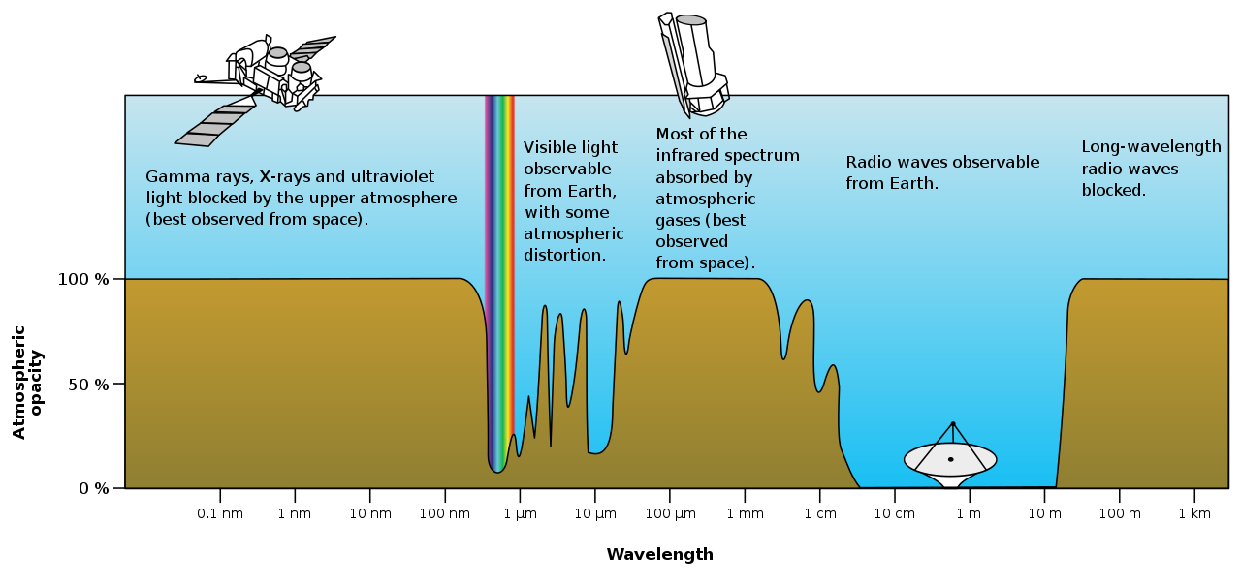
Core Data Concepts
Continuous vs. Discrete:
For example, is color data continuous or discrete? The does the term “color” even make sense?
X

Slide 32

Core Data Concepts
Continuous vs. Discrete:
Do not confuse numeric and ordered discrete data with continuous data!
X

Slide 33
Core Data Concepts
Continuous vs. Discrete:
Consider an airline with passenger classes: 1st, 2nd, and 3rd class. This is numeric data with a clear order, but it’s still discrete! There is no 1.57 passenger class.
X

Slide 34
Core Data Concepts
Continuous vs. Discrete:
To help distinguish this type of data, we need to consider nominal vs. ordinal data.
X

Slide 35
Core Data Concepts
Nominal vs. Ordinal:
Nominal data is classified without a natural order or rank.
X

Slide 36
Core Data Concepts
Nominal vs. Ordinal:
Nominal data is classified without a natural order or rank.
For example categories of discrete animals: dogs, cats, lizards, horses, etc…
X

Slide 37
Core Data Concepts
Nominal vs. Ordinal:
Nominal data is classified without a natural order or rank.
A good test for nominal data is if it can be clearly sorted or not. Nominal data can not be sorted.
X

Slide 38
Core Data Concepts
Nominal vs. Ordinal:
Ordinal data can be sorted (it has an order to it).
X

Slide 39
Core Data Concepts
Nominal vs. Ordinal:
Ordinal data can be sorted (it has an order to it). Our previous examples of passenger classes is an ordinal discrete data set.
X

Slide 40
Core Data Concepts
Nominal vs. Ordinal:
Ordinal data can be sorted (it has an order to it). We understand that 2nd class is in between 1st and 3rd class.
X

Slide 41

Core Data Concepts
Nominal vs. Ordinal:
Ordinal data doesn’t necessarily need to be numeric. Weather data terms such as “hot”, “mild”, and “cold” can be said to be ordinal.
X

Slide 42
Core Data Concepts
When thinking about continuous vs. discrete and nominal vs. ordinal, try to keep in mind the context of the problem you are trying to solve.
It may not be necessary to apply labels such as ordinal if they aren’t useful to the challenge at hand.
X

Slide 43
Core Data Concepts
Structured vs. Unstructured:
We also need to understand that not all data is formatted nicely in a table or spreadsheet, and in some cases we don’t even want it in a structured format!
X

Slide 44
Core Data Concepts
Structured vs. Unstructured:
Structured data is highly specific and is stored in a predefined format.
For example: Excel spreadsheets, JSON files, XML files, or SQL databases follow a predefined format.
X

Slide 45
Core Data Concepts
Structured vs. Unstructured:
Unstructured data is not in a particular format.
For example audio, video, or text data doesn’t need to follow any particular predefined structured format.
X

Slide 46
Core Data Concepts
Structured vs. Unstructured:
Unstructured data is not in a particular format.
Be careful not to confused computer encoded file formats with “formatted data”! Just because text is in a PDF format doesn’t make it structured data.
X

Slide 47
Core Data Concepts
Structured vs. Unstructured:
Typical unstructured data is harder to work with, but in certain fields it’s actually necessary to achieve results!
X

Slide 48
Core Data Concepts
Structured vs. Unstructured:
Many state of the art deep learning techniques use unstructured data to learn patterns and generate new objects.
X

Slide 49
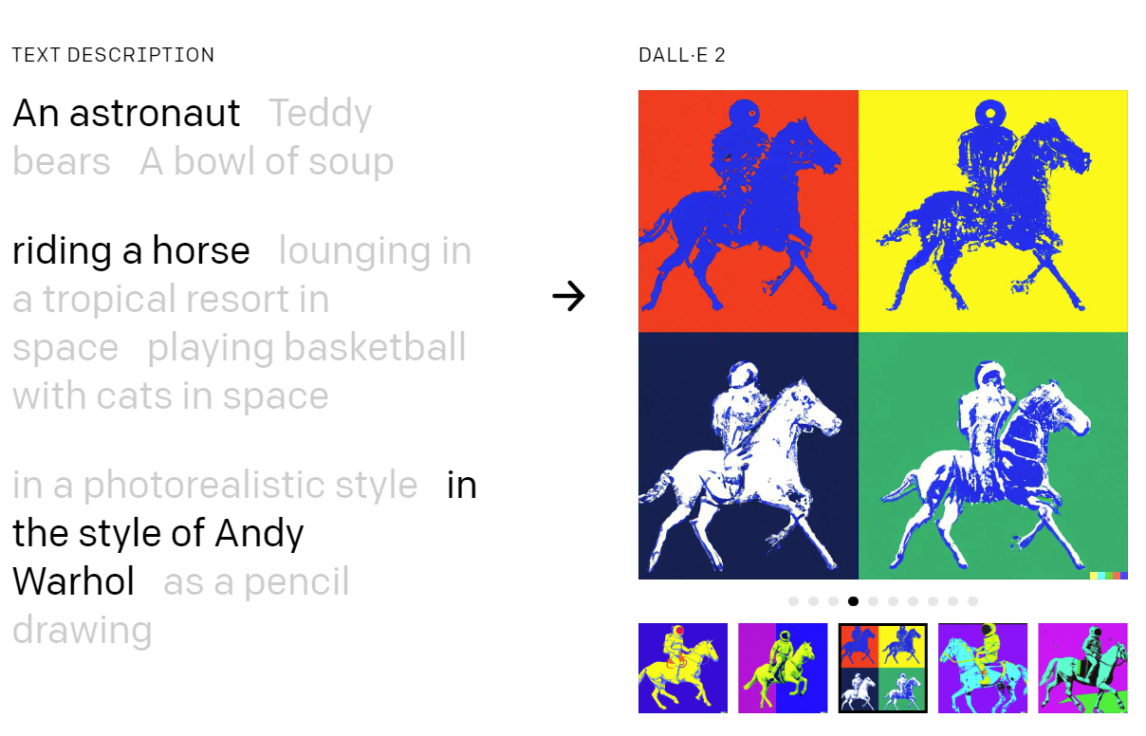
Core Data Concepts
Structured vs. Unstructured:
For example: DALLE-2 from OpenAI
X

Slide 50
Core Data Concepts
Population vs. Sample:
Finally, we also need to consider the scope of our data collection.
Is this data a full representation of everything available and known? Or is it a sample of everything?
X

Slide 51
Core Data Concepts
Population vs. Sample:
Population consists of every member of a group. This is dependent on the context of the situation.
For example a list of all the student names in a school contains data on the entire population.
X

Slide 52
Core Data Concepts
Population vs. Sample:
Don’t confuse the term “population” in this context with the population of an entire country. In the context of data science we use population to describe the entire available data set.
X

Slide 53
Core Data Concepts
Population vs. Sample:
Often however it is not possible to record data on an entire population.
In this case we rely on a sample from the population, which is a subset of the members of the group.
X

Slide 54
Core Data Concepts
Population vs. Sample:
For example an optional school survey that we only ask some students fill out would be a sample of a population.
We should always try to have samples that are representative of the population we’re trying to understand.
X

Slide 55
Core Data Concepts
Population vs. Sample:
Later on we’ll discover that sample sizes are a well studied science.
For example: How many students should we survey for a school of 1,000 students to get a representative sample?
X

Slide 56
Core Data Concepts
Population vs. Sample:
In case you're curious on the answer to that question, it actually depends a bit on our assumptions of the overall population and the task at hand. You can find out more now at: wikipedia.org/wiki/Sample_size_determination
X

Slide 57
Core Data Concepts
We’ve seen that data comes in different forms and that we need to be cognizant of the context surrounding the data and more importantly on what we are using the data for.
The ability to measure certain features of data is crucial to understanding data sets, especially numeric ones.
X

Slide 58
Core Data Concepts
Let’s continue by exploring two key concepts of data measurements:
Measurements of Central Tendency
Mean, Median , and Mode
Measurements of Dispersion
Variance and Standard Deviation
X

